Slide 1
Spring AspectJ
Instruction: NGUYEN ANH MINH (M. Sc.)

Slide 2
Outline
AspectJ APIs and annotations
Spring AOP application
AOP Proxies

Slide 3
AspectJ

Slide 4
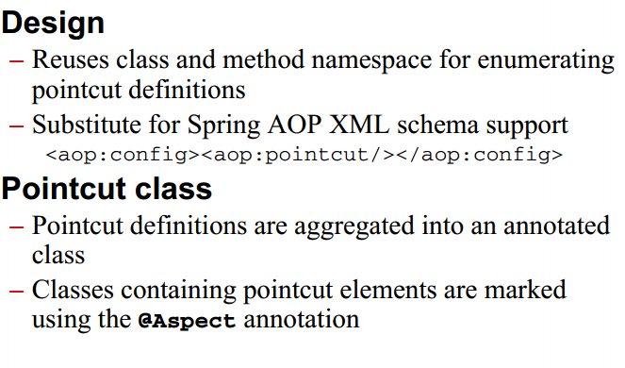
AspectJ pointcuts introducion

Slide 5
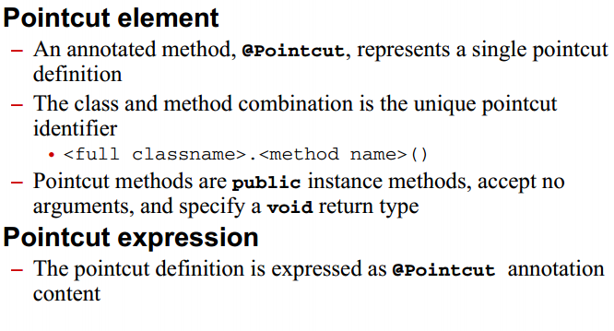
AspectJ pointcuts introduction

Slide 6
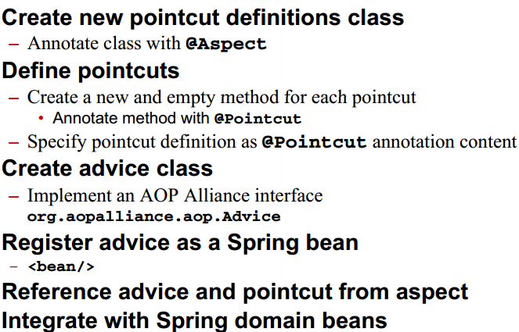
AspectJ pointcut process

Slide 7
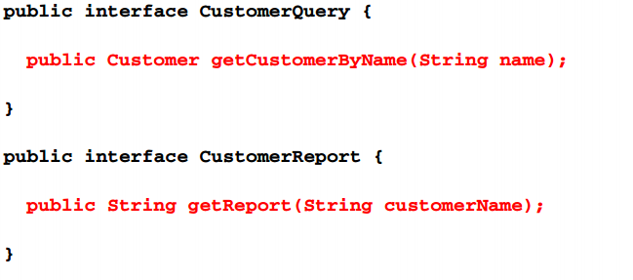
Select join point

Slide 8
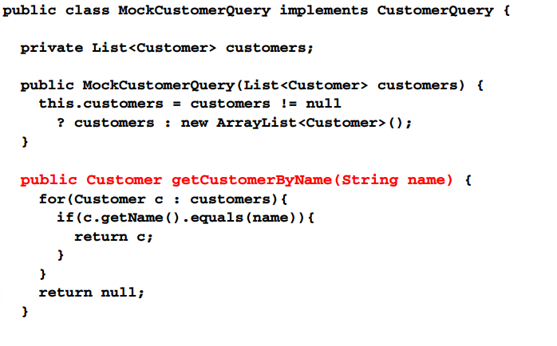
Select join point

Slide 9
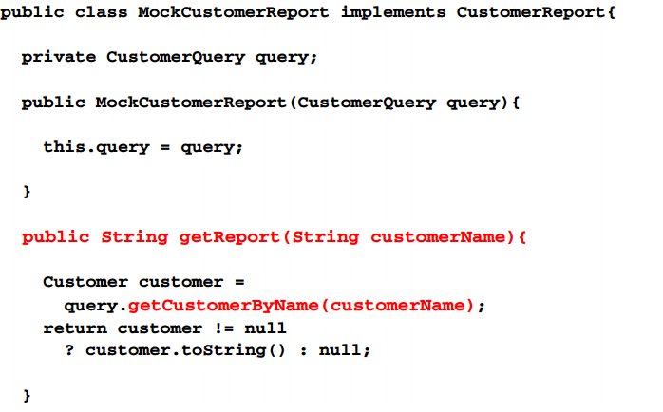
Select join point

Slide 10
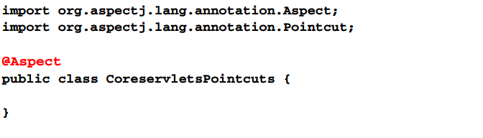
Create pointcut definition class

Slide 11
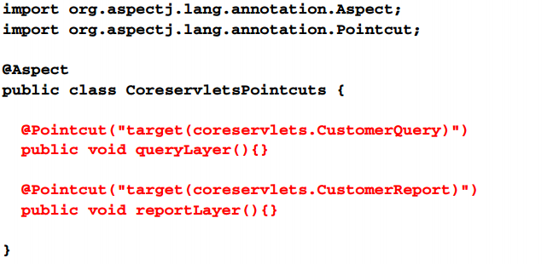
Define pointcut

Slide 12
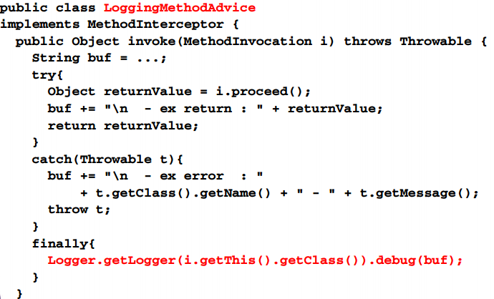
Create advice class

Slide 13
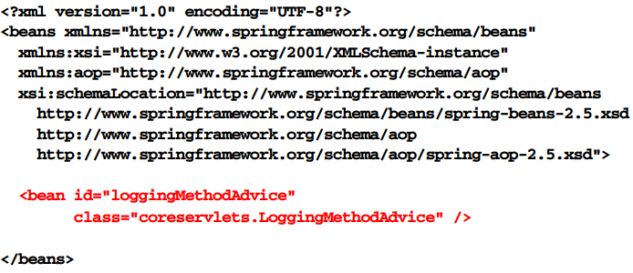
Register advice bean

Slide 14
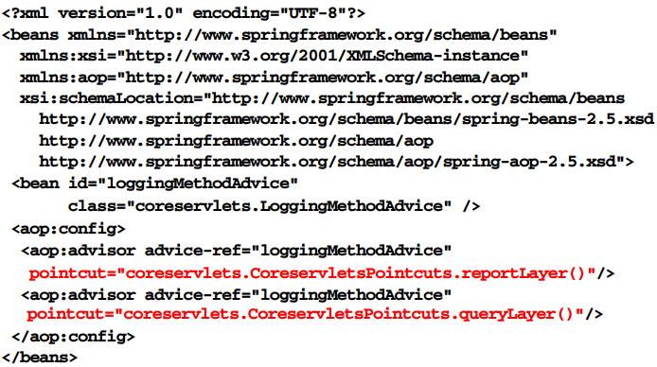
Define aspect

Slide 15
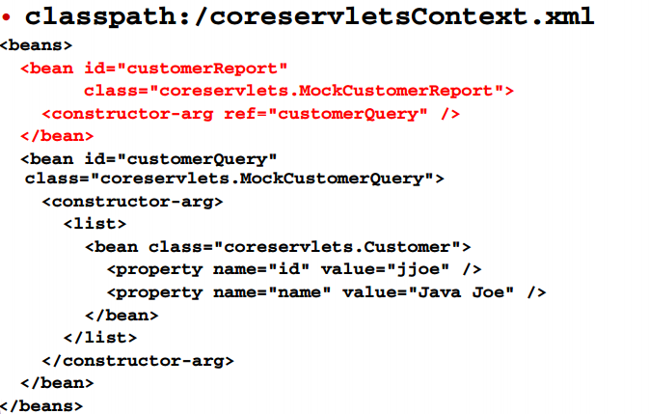
Domain beans

Slide 16
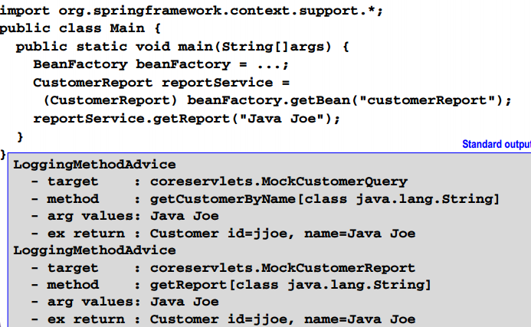
Access and use beans

Slide 17
AspectJ advice

Slide 18
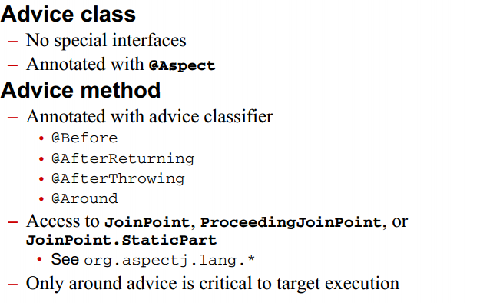
AspectJ advice introduction

Slide 19
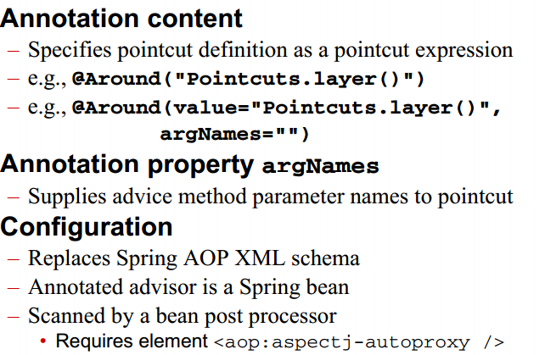
AspectJ advice

Slide 20
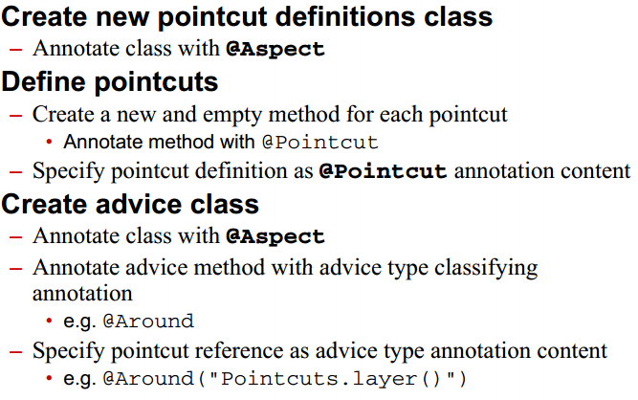
AspectJ pointcut process

Slide 21
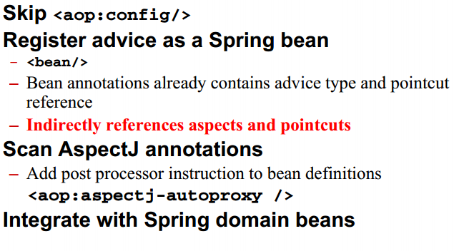
AspectJ pointcut process

Slide 22
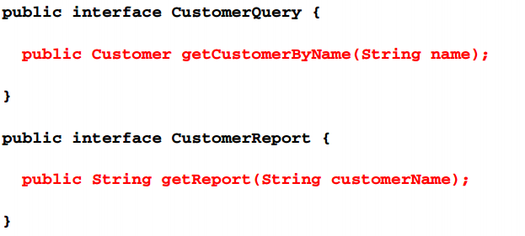
Select join points

Slide 23

Select join points

Slide 24
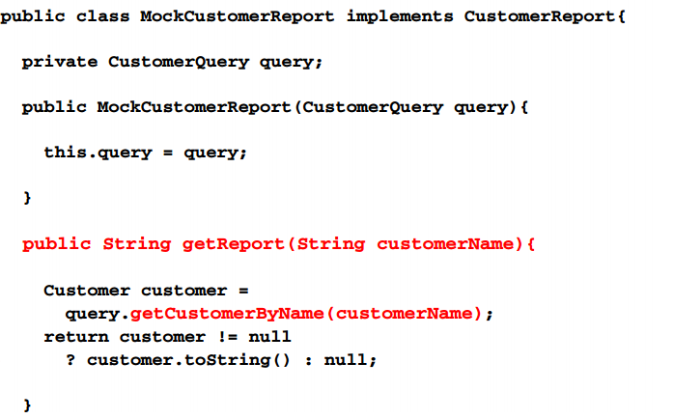
Select join points

Slide 25
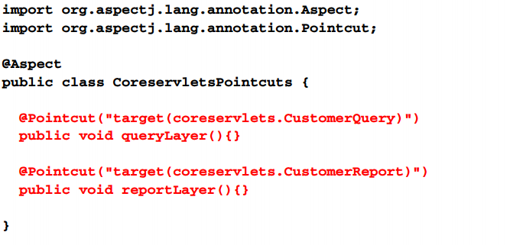
Define pointcuts

Slide 26
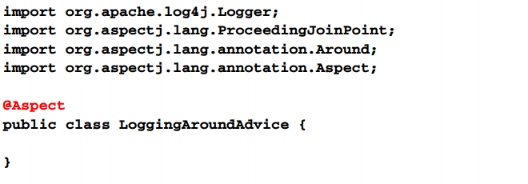
Create advice class

Slide 27
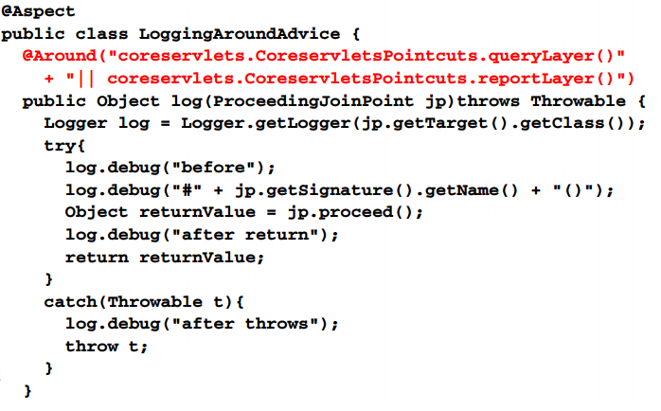
Create advice class

Slide 28
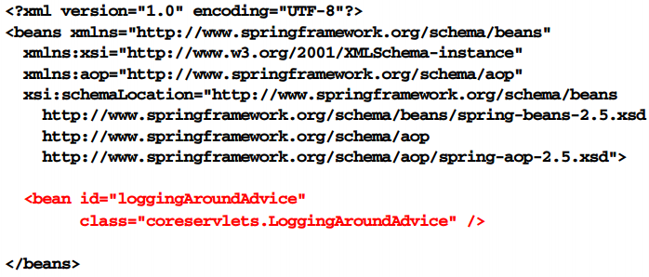
Register advice bean

Slide 29
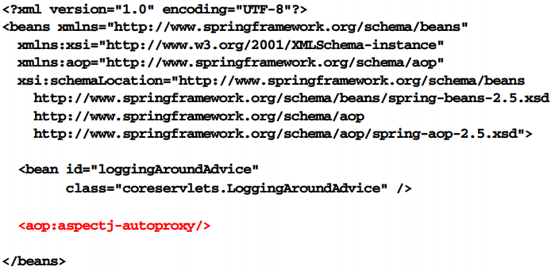
Register bean postprocessor

Slide 30
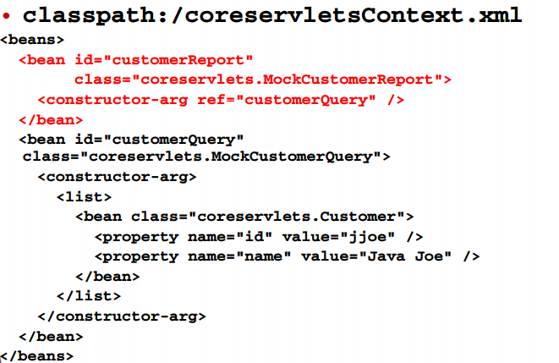
Domain beans

Slide 31
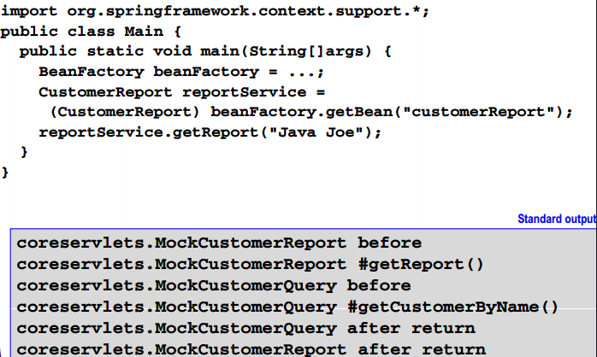
Access and use beans

Slide 32
AspectJ advice with spring AOP xml

Slide 33
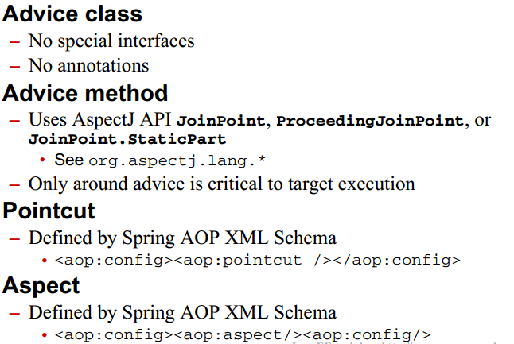
AspectJ advice with spring aop xml

Slide 34
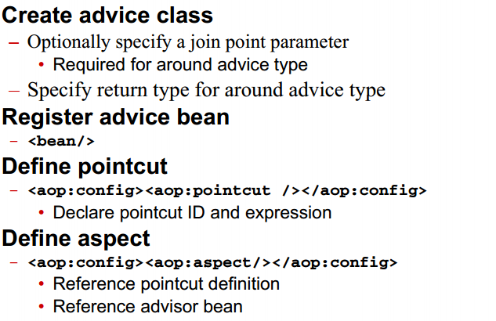
Process

Slide 35
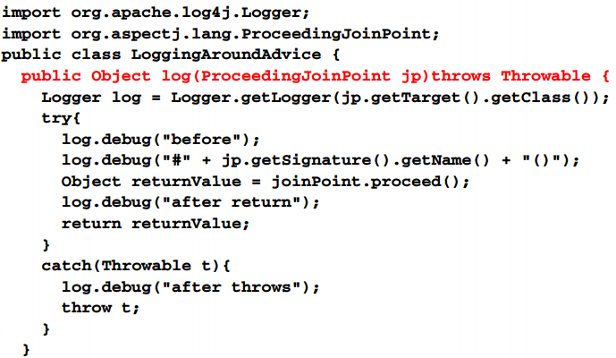
Create advice class

Slide 36
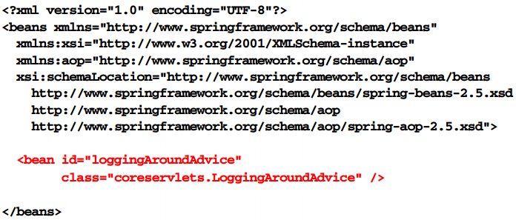
Register advice bean

Slide 37
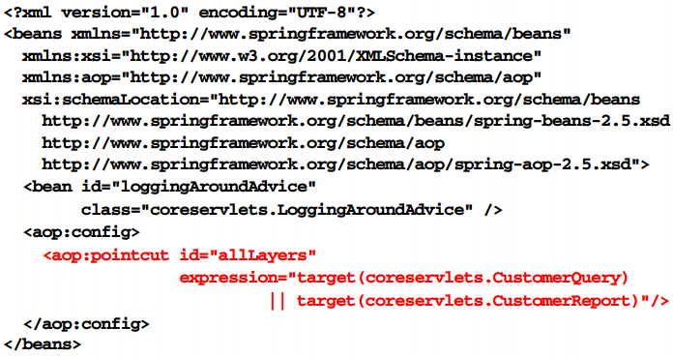
Define pointcut

Slide 38
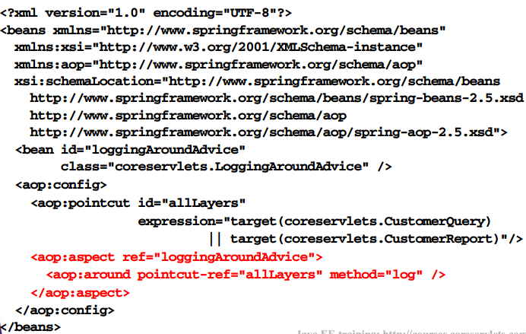
Define pointcut

Slide 39
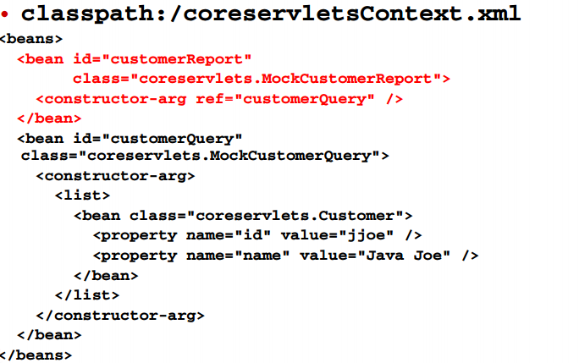
Domain beans

Slide 40
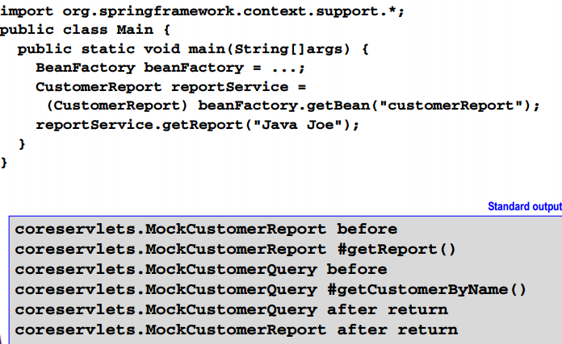
Access and use Beans

Slide 41
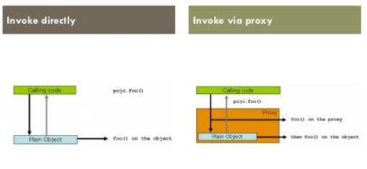
Aop proxy

Slide 42
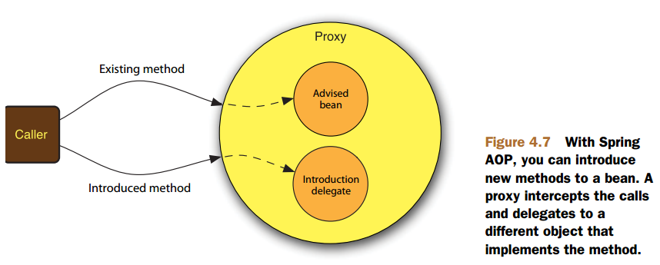
Aop proxy

Slide 43
Spring AOP application

Slide 44
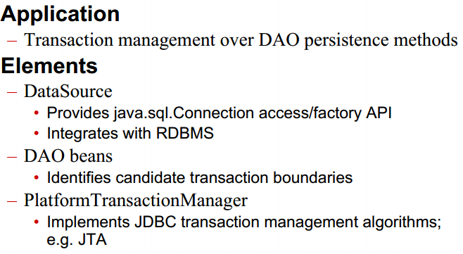
JDBC transaction management using AOP

Slide 45
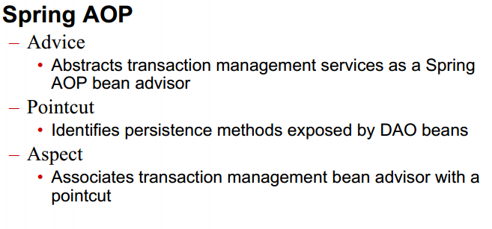
JDBC transaction management using AOP

Slide 46
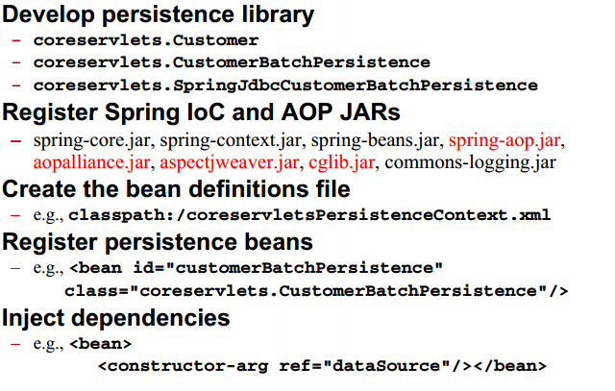
Process

Slide 47
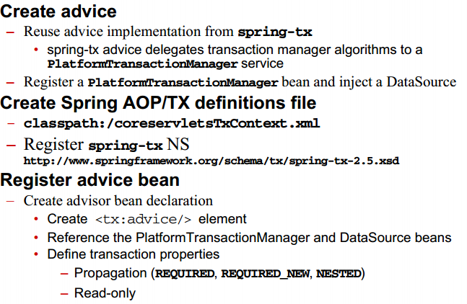
Process

Slide 48
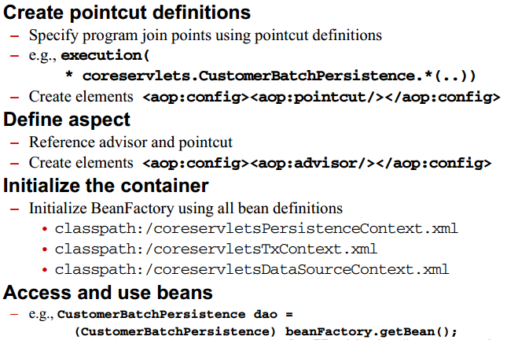
Process

Slide 49
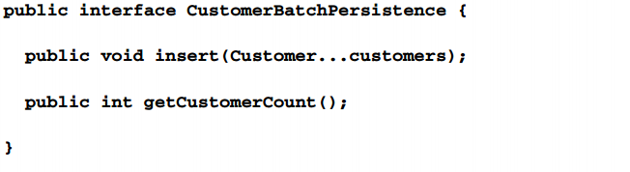
Develop persistence library

Slide 50
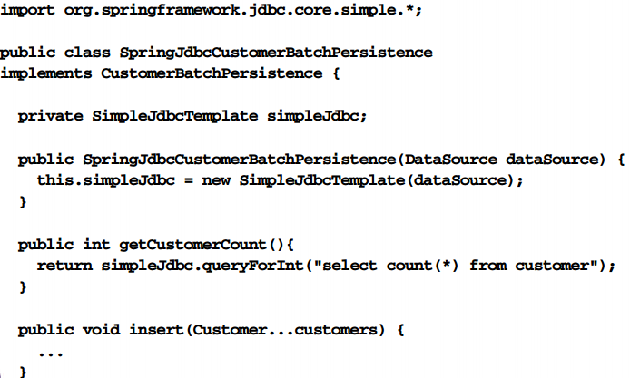
Develop persistence library

Slide 51
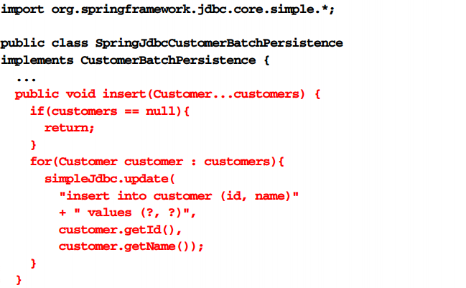
Develop persistence library

Slide 52
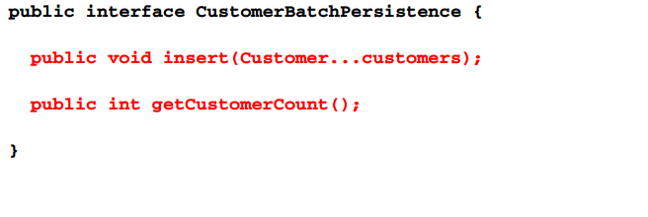
Select join points

Slide 53
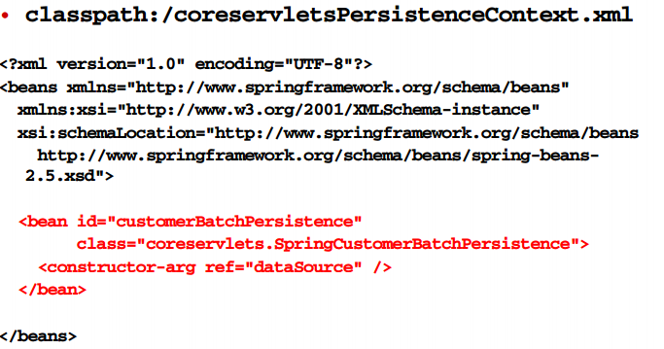
Create bean definitions

Slide 54
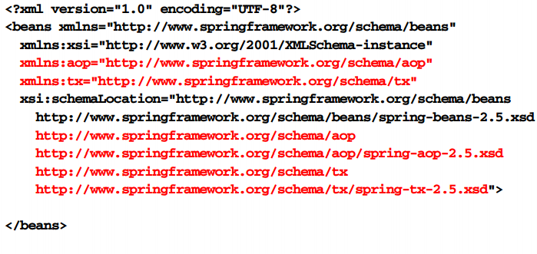
Create spring AOP/tx definitions

Slide 55
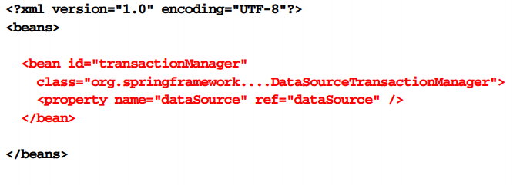
Register transaction manager

Slide 56
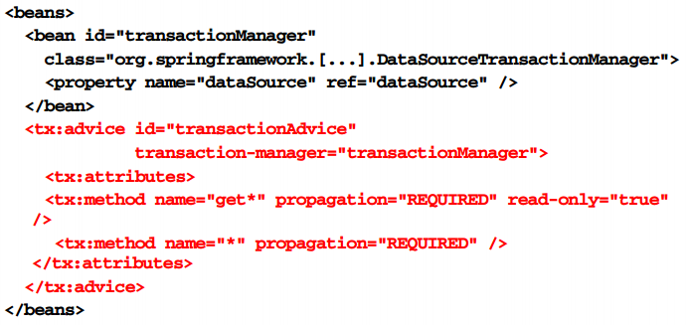
Register advice bean

Slide 57
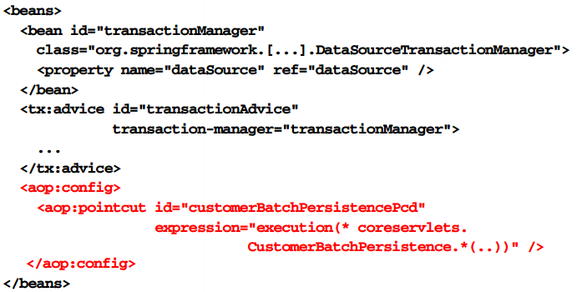
Define pointcuts

Slide 58

Define aspect

Slide 59

Initializer container

Slide 60

Test transaction manager

Slide 61

Summary

Slide 62

Summary

